Slide 1
Efficiency & Run Time Analysis
Week 6, Summer 2024. 7/22 (Mon)

Slide 2
Announcements
Project02 (“Ants”) out!
Mid-point course survey out (optional, +2 extra credit points)
Due: 7/29 11:59 PM PST

Slide 3
Efficiency & Run Time Analysis

Slide 4
Learning Objectives
Runtime Analysis:
How long will my program take to run?
Why can’t we just use a clock?
How can we simplify understanding computation in an algorithm
Enjoy this stuff? Take 61B!
Find it challenging? Don’t worry! It’s a different way of thinking.

Slide 5
Efficiency is all about trade-offs
Running Code: Takes Time, Requires Memory
More efficient code takes less time or uses less memory
Any computation we do, requires both time and "space" on our computer.
Writing efficient code is not obvious
Sometimes it is even convoluted!
But!
We need a framework before we can optimize code
Today, we're going to focus on the time component.

Slide 6
Is this code fast?
Most code doesn’t really need to be fast! Computers, even your phones are already amazingly fast!
Sometimes…it does matter!
Lots of data
Small hardware
Complex processes
Slow code takes up battery power

Slide 7
Beware!
"Premature Optimization is the root of all evil"
- Donald Knuth, Stanford CS Professor
There is no use in fast code if it is wrong!

Slide 8
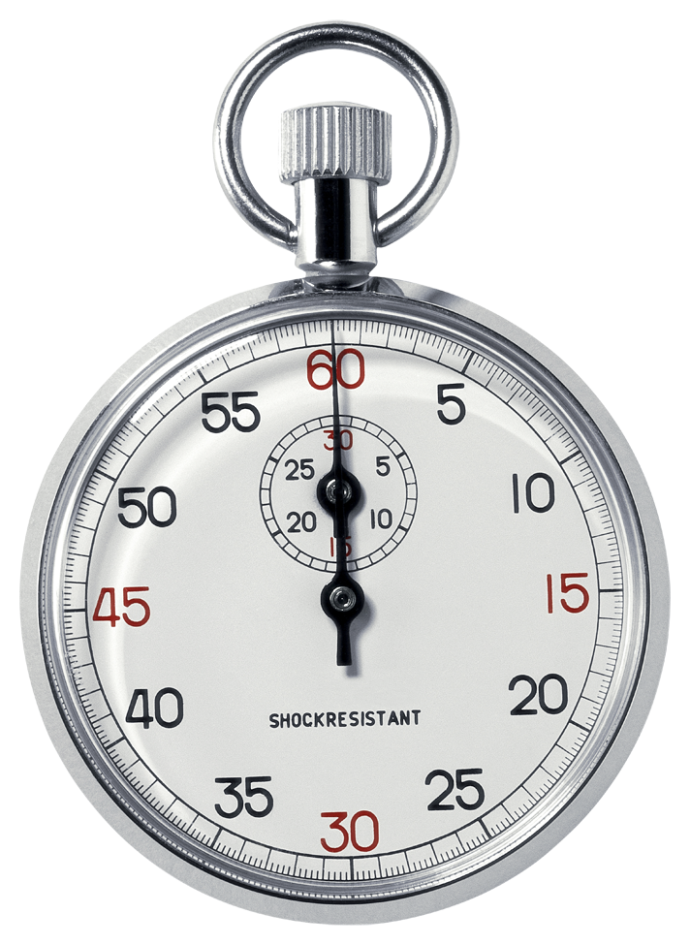
Runtime analysis problem & solution
Time w/stopwatch, but…
Different computers may have different runtimes. ☹
Same computer may have different runtime on the same input. ☹
Need to implement the algorithm first to run it. ☹
Solution: Count the number of “steps” involved, not time!
Each operation = 1 step
1 + 2 is one step
lst[5] is one step
When we say “runtime”, we’ll mean # of steps, not time!

Slide 9
Runtime: input size & efficiency
Definition:
Input size: the # of things in the input.
e.g. length of a list, the number of iterations in a loop.
Running time as a function of input size
Measures efficiency
Important!
In CS88 we won’t care about the efficiency of your solutions!
…in CS61B we will
C88C
CS61B
CS61C

Slide 10
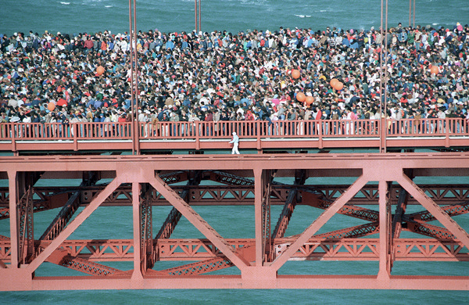
Runtime analysis : worst or average case?
Could use avg case:
Average running time over a vast # of inputs
Instead: use worst case
Consider running time as input grows
Why?
Nice to know most time we’d ever spend
Worst case happens often
The "average" can be similar to the worst
Often called “Big O” for "order"
O(1), O(n) …

Slide 11
Runtime analysis: Final abstraction
Instead of an exact number of operations we’ll use abstraction
Want order of growth, or dominant term
In CS88 we’ll consider
Constant O(1)
Logarithmic O(log n)
Linear O(n)
Quadratic O(n²)
Exponential O(2^{n})
E.g. 10n² + 4log(n) + n
…is quadratic
Exponential
Cubic
Quadratic
Linear
Logarithmic
Constant
Graph of order of growth curves on log-log plot

Slide 12

Example: Finding a student (by ID)
Input
Unsorted list of students L
Find student S
Output
True if S is in L, else False
Pseudocode Algorithm
Go through one by one, checking for match.
If match, true
If exhausted L and didn’t find S, false
Worst-case running time as function of the size of L?
Constant
Logarithmic
Linear
Quadratic
Exponential
Intuition: if we double the length of L, then it takes 2x as long to find S.

Slide 13
Computational Patterns
If the # of steps to solve a problem is always the same → Constant time: O(1)
If the # of steps increases similarly for each larger input → Linear Time: O(n)
Most commonly: for each item
If the # of steps increases by some factor of the input → Quadradic Time: O(n²)
Most commonly: Nested for Loops
Two harder cases:
Logarithmic Time: O(log n)
We can double our input with only one more level of work
Dividing data in “half” (or thirds, etc)
Exponential Time: O(2^{n})
For each bigger input we have 2x the amount of work!
Certain forms of Tree Recursion

Slide 14
Example: Finding a student (by ID)
Input
Sorted list of students L
Find student S
Output : same
Pseudocode Algorithm
Start in middle
If match, report true
If exhausted, throw away half of L and check again in the middle of remaining part of L
If nobody left, report false
Worst-case running time as function of the size of L?
Constant
Logarithmic
Linear
Quadratic
Exponential
Intuition: each step halves the size of L, strong sign of log
Question: what is the base of log(len(L))? Log_e? log_10? Log_2?
Answer: log_2 (base 2), since we halve the input size at each step.

Slide 15
Comparing Fibonacci
def iter_fib(n):
x, y = 0, 1
for _ in range(n):
x, y = y, x+y
return x
def fib(n): # Recursive
if n < 2:
return n
return fib(n - 1) + fib(n - 2)
Question: what is the run time of `iter_fib()`, with respect to input `n`?
Answer: O(n), aka linear.
Intuition: doubling `n` leads to 2x more for loop iters, and each for loop iter has a constant number of operations.
Tip: Determining the run time for recursive fib is less straightforward…

Slide 16
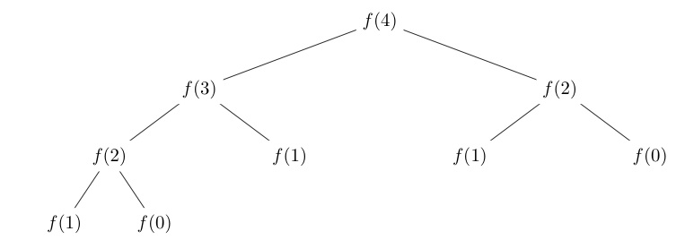
Tree Recursion
Fib(4) → 9 Calls
Fib(5) → 16 Calls
Fib(6) → 26 Calls
Fib(7) → 43 Calls
Fib(20) →

Slide 17
Why?
Notice there was all this duplication in the tree?
What is the exact order of growth?
It's exponential.
O(φ ^{n} ), where phi (φ) is the golden ratio (φ=1.618…)
N | Operations
1 | 1
2 | 3
3 | 5
4 | 9
7 | 41
8 | 67
20 | 21891
Tip: In this class, we won’t expect you to be able to prove this result. We’ll focus on simpler order of growths like: O(1), O(log(n)), O(n), O(n^2), O(2^n), etc.
(Aside) To see how to derive this O(phi^n) result, see: https://www.geeksforgeeks.org/time-complexity-recursive-fibonacci-program/

Slide 18
Efficiency of Linked Lists vs python Lists
Linked Lists generally use less memory.
But this can make it slower to compute data.
Linked Lists:
Once you've found an item, inserting / removing is easy, O(1)
Finding anything other than the first/last item is O(n)
"Regular“ (python built-in) Lists:
Inserting / Removing items, other than the last is O(n) – due to internal copying
Finding any random item is O(1).
What if you need to iterate over all items in order?
O(n) in both cases
Tip: you can look up Python’s built-in list/dict operation run-times here: https://wiki.python.org/moin/TimeComplexity

Slide 19
Efficiency of dicts
Dictionaries (aka hash table, hash map) are an extremely useful tool because of its (amortized) constant time insertion/deletion/contains methods
(Aside) dicts are a central technique to efficiently solve many technical coding interview questions
What’s the catch?
“Good” hash function to avoid collisions
“Amortized”: on average, constant time. But, at worst case, linear time.
Important: runtime analysis is complicated by average vs worst case, eg “expected number of operations” (eg probability)
In this class we won’t delve into why dicts behave this way (CS 61B does)

Slide 20
Improving Efficiency

Slide 21
Learning Objectives
Learn how to cache the results to save time.
"memoization" is a specific version to avoid repeated calculations

Slide 22
Example
Use a dictionary to cache results.
This is called memoization
fib_results = {}
def memo_fib(n): # Look up values in our dictionary.
global fib_results
if n in fib_results:
print(f'found {n} -> {fib_results[n]}')
return fib_results[n]
if n < 2:
fib_results[n] = n
return n
result = memo_fib(n - 1) + memo_fib(n - 2)
fib_results[n] = result
return result

Slide 23
A Better Approach
Python's functools module has a `cache` function
Uses a technique called decorators that we don't cover.
Decorators are really just a "shortcut" for higher order functions.
e.g. cache_fib = cache(fib) is a similar approach to the function below, but less commonly used.
from functools import cache
@cache
def cache_fib(n): # Recursive
if n < 2:
return n
return cache_fib(n - 1) + cache_fib(n - 2)

Slide 24
What next?
Understanding algorithmic complexity helps us know whether something is possible to solve.
Gives us a formal reason for understanding why a program might be slow
This is only the beginning:
We’ve only talked about time complexity, but there is space complexity.
In other words: How much memory does my program require?
Often you can trade time for space and vice-versa
Tools like “caching” and “memorization” do this.
If you think this is cool take CS61B!

